Slide 1
The Art of Anticoagulation: Balancing the
Benefits vs. Risks
Gina Winchester
PharmD Candidate, Class of 2013
UNC Eshelman School of Pharmacy

Slide 2
Objectives
Highlight common reasons to use anticoagulation
Review anticoagulant and antiplatelet therapy
Discuss important monitoring parameters and clinical pearls regarding anticoagulation

Slide 3
Why Do We Care?
Most of the common cardiovascular diseases have a relationship to the clotting process
Many of the cardiovascular diseases are also more common in the elderly
Total costs for cardiovascular disease were $121.2 billion for patients 65 years old and older in 2009
Gage BF, Fihn SD, White RH. Ann Intern Med. 2001;134:465.
Go AS, Mozaffarian D, Roger VL, et al. Circulation. 2013;127:e000-e000.
Notes:
In 2009 – that was the cost estimate. That amount accounts for about 40% of the TOTAL (all ages) CVD costs.
Full citation: Gage BF, Fihn SD, White RH. “Warfarin therapy for an octogenarian who has atrial fibrillation.” Ann Intern Med. 2001;134:465.
Full citation: Go AS, Mozaffarian D, Roger VL, et al. “on behalf of the American Heart Association Statistics Committee and Stroke Statistics Subcommittee. Heart Disease and stroke statistics-2013 update: a report from the American Heart Association.” Circulation. 2013;127:e000-e000.

Slide 4
The Clotting Process: Coagulation
Anticoagulants (also called blood thinners) work to decrease the clotting ability of the blood
  Help to prevent harmful clots from forming in blood vessels
  May prevent clots from becoming larger and causing more serious issues
  Can help reduce the risk of having a stroke or other serious adverse events
“Cardiac Medications.” American Heart Association. Accessed Online March 12, 2013. Available at: <http://www.heart.org/HEARTORG/Conditions/HeartAttack/PreventionTreatmentofHeartAttack/Cardiac-Medications_UCM_303937_Article.jsp>.
Notes:
They do not actually thin the blood or dissolve existing blood clots.

Slide 5
The Clotting Process: Coagulation
Antiplatelet agents keep blood clots from forming by preventing blood platelets from sticking together
  Help prevent clot formation in patients with some form of cardiovascular disease
  Often times given as prevention for plaque buildup that is not yet causing a large obstruction in the artery
“Cardiac Medications.” American Heart Association. Accessed Online March 12, 2013. Available at: <http://www.heart.org/HEARTORG/Conditions/HeartAttack/PreventionTreatmentofHeartAttack/Cardiac-Medications_UCM_303937_Article.jsp>.

Slide 6
Potential Reasons to AVOID Anticoagulation
Severe liver impairment
Alcoholism
Active bleeding
History of bleeding
Current ulcers
Uncontrolled high blood pressure
High fall risk or frequent falls
Man-Son-Hing M, Laupacis A. Arch Intern Med. 2003;163:1580-1586.
Notes:
This is IN GENERAL.
Risk factors for bleeding (per aspirin on uptodate): >75 yo, concomitant oral/parenteral corticosteroids, anticoagulants, antiplatelet agents

Slide 7
Reasons to USE Anticoagulation
Acute Coronary Syndromes (ACS)
  Heart attack
  Unstable angina
Atrial Fibrillation
Venous Thromboembolism (VTE)
  Deep vein thrombosis (DVT)
  Pulmonary embolism (PE)
Peripheral Artery Disease
Prosthetic Heart Valve Replacements
Ischemic Stroke
“Anticoagulation.” American Heart Association . Accessed Online March 12, 2013. Available at: <http://www.heart.org/HEARTORG/Conditions/CongenitalHeartDefects/TheImpactofCongenitalHeartDefects/Anticoagulation_UCM_307110_Article.jsp>.
Notes:
ACS= imbalance of myocardial oxygen demand and supply. In contrast to stable angina, an ACS results mainly from decreased blood flow to the heart secondary to an occlusive or partially occlusive coronary artery thrombosis. ACS is classified by electrocardiograph (ECG) into STEMI (STE ACS), or NSTE (NSTEMI or unstable angina). NSTEMI is not the same as unstable angina b/c in the case of a NSTEMI, biomarkers like troponin I or T and creatine kinase myocardial band (CK MB) are release into the bloodstream from the necrotic myocytes.
*Ischemic stroke only – never hemorrhagic stroke because that is due to a blood vessel rupture and by giving them an agent that increases bleeding you would do even more serious damage/likely be fatal.

Slide 8
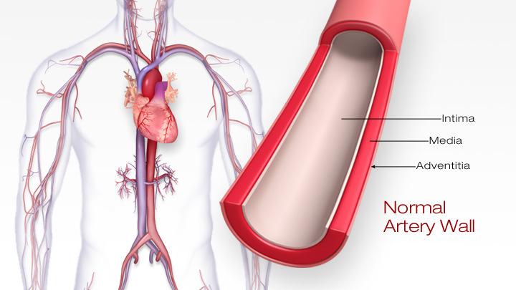
Precursor to Acute Coronary Syndromes: Atherosclerosis
Image available at: <http://watchlearnlive.heart.org/CVML_Player.php?moduleSelect=athero>.
Notes:
Atherosclerosis is NOT THE MAIN or ONLY cause that can lead to ACS but it is one of the most common causes of ACS.

Slide 9
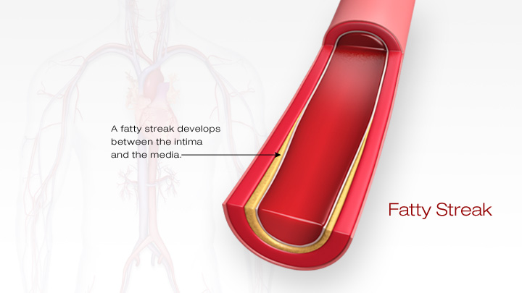
Progression of Atherosclerosis
Image available at: <http://watchlearnlive.heart.org/CVML_Player.php?moduleSelect=athero>.
Notes:
http://watchlearnlive.heart.org/CVML_Player.php?moduleSelect=athero

Slide 10
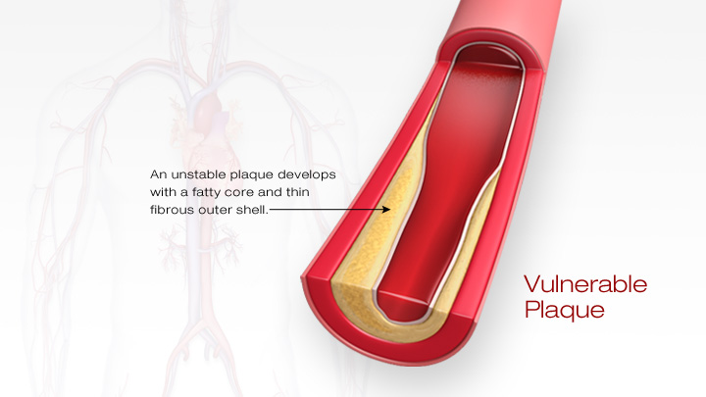
Progression of Atherosclerosis
Image available at: <http://watchlearnlive.heart.org/CVML_Player.php?moduleSelect=athero>.

Slide 11
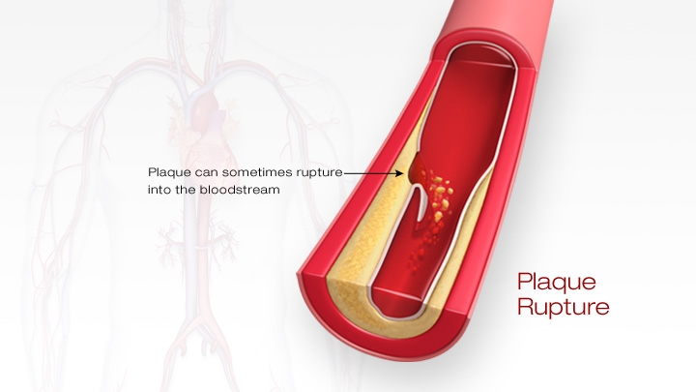
Progression of Atherosclerosis
Image available at: <http://watchlearnlive.heart.org/CVML_Player.php?moduleSelect=athero>.

Slide 12
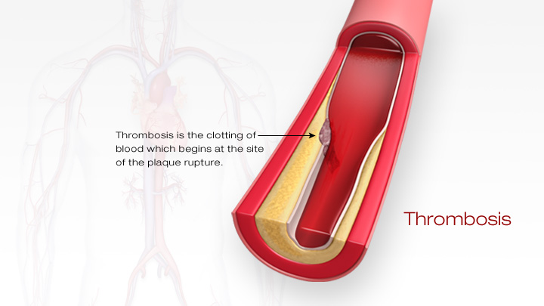
Progression of Atherosclerosis
Image available at: <http://watchlearnlive.heart.org/CVML_Player.php?moduleSelect=athero>.

Slide 13
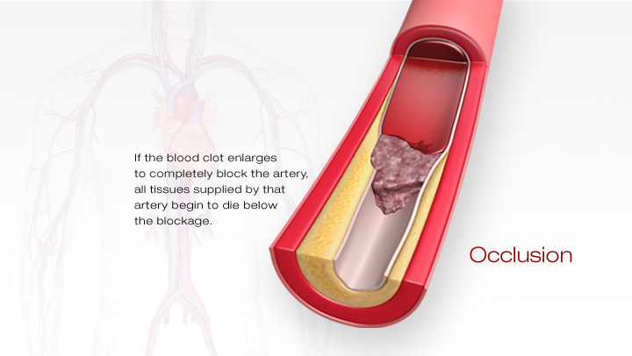
Atherosclerosis leading to an
Acute Coronary Syndrome
Image available at: <http://watchlearnlive.heart.org/CVML_Player.php?moduleSelect=athero>.

Slide 14
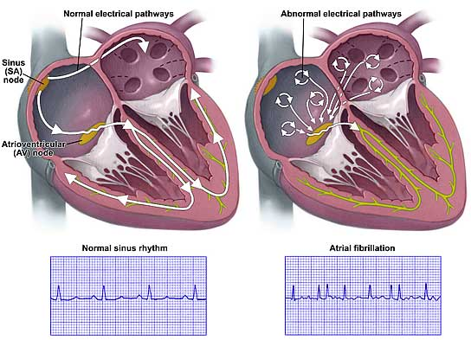
Atrial Fibrillation
Image available at: <http://www.strokesurvivors.ca/new/images/atrial-fibrillation-lg.jpg>.
Notes:
Irregularly irregular heart beats – too fast or slow with irregular rhythms.

Slide 15
Atrial Fibrillation: Factors that Increase Stroke Risk
Heart failure
High blood pressure
Age 75 years old or greater
Diabetes mellitus
Previous stroke or transient ischemic attack (TIA)
Female sex
Pamukcu B, Lip GYH, Lane DA. Age and Ageing. 2010;39:533-535.
Notes:
CHADS-2 (CHF, HTN, 75 YO and up, DM, Stroke/TIA)
Score of 0= none or aspirin (low risk)
Score of 1= aspirin or warfarin (moderate risk)
Score of 2+ = warfarin (mod-high risk)
CHA₂DS₂-VASc (CHF, HTN, Age 75 +, DM, Stroke/TIA, Vascular disease like MI/PAD, Age 65-74, female)

Slide 16
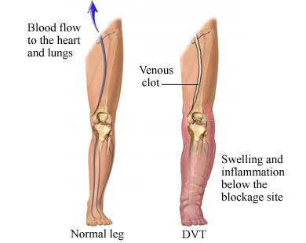
Venous Thromboembolism
Image available at: <http://www.circulationfoundation.org.uk/wp-content/uploads/2012/03/DVT.jpeg>.
Notes:
DVT usually occurs in lower extremities
DVT located in the calf veins is associated with smaller clots and less complications
Proximal DVT can involve the popliteal, femoral, or iliac veins and often times can lead to a PE and post-thrombotic syndrome
PE results from a DVT that has been dislodged and traveled to the lungs
DVT usually occurs in extremities but can also occur in arms, cerebral sinuses, and viscera
PE is fatal in about 4-9% of cases.
Post-thrombotic syndrome is a condition that is due to chronic venous insufficiency. This can result in swelling of the calf which can lead to brownish-red skin discoloration, pain, and venous ulceration. It can even lead to disability in severe cases. Only mild-moderate forms of PTS are usually seen and severe cases are rare though.

Slide 17
Venous Thromboembolism
Risk Factors
Unprovoked (Idiopathic) | Provoked (Secondary)
No apparent cause Age greater than 65 years old Obesity Cigarette smoking High blood pressure Metabolic syndrome | Transient Risk Factors Surgery Trauma Immobilization Confinement to the bed Lengthy travel Estrogen therapy (OCP) Pregnancy Persistent/Irreversible Risk Factors Cancer Bleeding disorders Heart failure
Goldhaber S, Bounameaux H. Lancet. 2012; 379:1835-46.
Zhu T, Martinez I, Emmerich J. Arterioscler Thromb Vasc Biol. 2009; 29:298-310.

Slide 18
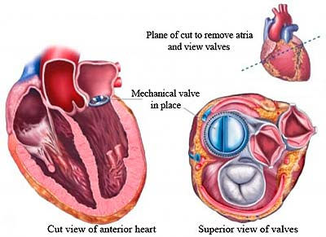
Heart Valve Replacement
Image available at: <http://media.radiosai.org/journals/Vol_06/01NOV08/09-healingtouch.htm>.

Slide 19
Anticoagulant Agents
Coumadin (warfarin)
Eliquis (apixaban)
Pradaxa (dabigatran)
Xarelto (rivaroxaban)
Lovenox (enoxaparin)
Arixtra (fondaparinux)

Slide 20

Coumadin (warfarin)
Purpose
  Prevention and treatment of clotting disorders and complications due to atrial fibrillation or cardiac valve replacement
Dosing
  In geriatrics, dose is usually less than 5 mg a day
  Dose is determined by INR
  Usual INR goal is 2.0-3.0
“Coumadin.” Accessed March 16, 2013. Available online at: <www.coumadin.com>.
Notes:
Geriatrics tend to need lower doses to achieve therapeutic INR’s due to changes in the warfarin metabolism.

Slide 21
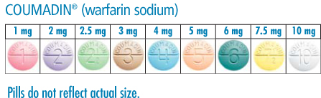
Coumadin (warfarin)
Dosage strengths
  1 mg, 2 mg, 2.5 mg, 3 mg, 4 mg, 5 mg, 6 mg, 7.5 mg, 10 mg tablets
“Coumadin.” Accessed March 16, 2013. Available online at: <www.coumadin.com>.
Notes:
Geriatrics tend to need lower doses to achieve therapeutic INR’s due to changes in the warfarin metabolism.

Slide 22
Coumadin (warfarin)
Black Box Warning: May cause major or fatal bleeding (Note: risk is increased in patients 65 years old or older).
Special Considerations
  Elderly may be more sensitive to anticoagulation
  High alert medication = increased risk of serious side effects if used in error
Side Effects
  Bleeding (ie. blood in urine or stool, nose bleeds, bruising)
“Coumadin.” Accessed March 16, 2013. Available online at: <www.coumadin.com>.
Notes:
Risk factors for the BBW: age 65 years old or greater, INR >4, variable INRs, history if GIB, HTN, serious heart disease, anemia, severe diabetes, cancer, trauma, kidney insufficiency, hx of PUD, DDIs, genetic 2c9 deficiency.

Slide 23
Coumadin (warfarin)
Monitoring Parameters
  INR (International Normalization Ratio) is measured routinely
    Blood test that reflects the amount of anticoagulation
    Measured more frequently in the beginning until INR stabilizes then measurements can be spaced out longer (ie. every 4 weeks)
    HIGH INR (ie. greater than 3.0)= increased risk of BLEEDING (too much anticoagulation)
    LOW INR (ie. less than 2.0)= increased risk of CLOTTING (not enough anticoagulation)
  Lots of drug and food interactions – can lead to high or low INR
“Coumadin.” Accessed March 16, 2013. Available online at: <www.coumadin.com>.

Slide 24
Coumadin (warfarin)
Dietary Considerations
  Food/drink that contains VITAMIN K influence the effects of Coumadin
  Foods HIGH in vitamin K = DECREASE INR
  Ensure CONSISTENCY from week to week with consumption of food/drink that contains vitamin K
“Coumadin.” Accessed March 16, 2013. Available online at: <www.coumadin.com>.
Notes:
Example: If a patient has 3 servings of salad/greens this week, recommend they have 3 servings of salad next week as well, etc.

Slide 25


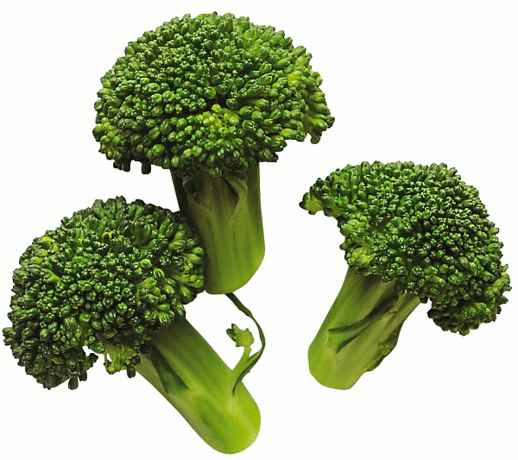
Coumadin (warfarin)
Dietary Considerations
  Food/drink with high vitamin K content:
    Dark leafy greens (ie. spinach, kale, collards, turnip greens)
    Broccoli
    Cabbage/salad
    Mayonnaise
    Livermush
    Green tea
“Coumadin.” Accessed March 16, 2013. Available online at: <www.coumadin.com>.
Notes:
Just to give you an idea of foods to look out for, list is NOT all-inclusive.
Salad image: <http://1.bp.blogspot.com/_7Ytpo8lvroU/SxRmvRE1c1I/AAAAAAAAAI0/dp7r8h_E80I/s1600/salad,+plain+greens.jpg
Broccoli image: <http://gourmay.net/wp-content/uploads/2013/03/broccoli.png>.
Mayonnaise: <http://www.hellmanns.com/Images/380/380-97846.png>.

Slide 26

Eliquis (apixaban)
New medication (FDA approved Dec. 28, 2012)
Purpose
  For prevention of stroke or embolism in patients with atrial fibrillation
Dosing
  5 mg twice a day
  2.5 mg twice a day if the patient has 2 of the following:
    80 years old or older
    Weighs 132 lb or less
    SCr 1.5 or greater
Dosage Strengths
  2.5 mg and 5 mg tablets
“Eliquis.” Accessed March 15, 2013. Available online at: <https://www.hcp.eliquis.com/Pages/index.aspx>.
“Eliquis.” UpToDate. Accessed March 15, 2013. Available online at: <www.uptodate.com>.

Slide 27
Eliquis (apixaban)
Black Box Warning: Discontinuing Eliquis in patients without adequate continuous anticoagulation INCREASES risk of stroke
Special Considerations
  Avoid grapefruit juice
  Concentrations are increased in the elderly
  High alert medication = increased risk of serious side effects if used in error
“Eliquis.” Accessed March 15, 2013. Available online at: <https://www.hcp.eliquis.com/Pages/index.aspx>.
“Eliquis.” UpToDate. Accessed March 15, 2013. Available online at: <www.uptodate.com>.
Notes:
65 years old and greater – systemic exposure is increased by about 32%. Do not have to dose reduce though unless they meet the above criteria (previous slide).
3A4 substrate & Pgp. DDI: ketoconazole, ritonavir, carbamazepine, St. John’s wort, etc.
Not recommended to be used with other NSAIDs or aspirin.
From Eliquis website: “Switching from warfarin to ELIQUIS: Warfarin should be discontinued and ELIQUIS started when the international normalized ratio (INR) is below 2.0.
Switching from ELIQUIS to warfarin: ELIQUIS affects INR, so that INR measurements during coadministration with warfarin may not be useful for determining the appropriate dose of warfarin. If continuous anticoagulation is necessary, discontinue ELIQUIS and begin both a parenteral anticoagulant and warfarin at the time the next dose of ELIQUIS would have been taken, discontinuing the parenteral anticoagulant when INR reaches an acceptable range.
Switching between ELIQUIS and anticoagulants other than warfarin: Discontinue one being taken and begin the other at the next scheduled dose.”

Slide 28
Eliquis (apixaban)
Side Effects
  Bleeding
Monitoring Parameters
  No routine monitoring
  Will cause an increase in INR
  No reversal agent
  Lots of drug interactions
“Eliquis.” Accessed March 15, 2013. Available online at: <https://www.hcp.eliquis.com/Pages/index.aspx>.
“Eliquis.” UpToDate. Accessed March 15, 2013. Available online at: <www.uptodate.com>.
Notes:
65 years old and greater – systemic exposure is increased by about 32%. Do not have to dose reduce though unless they meet the above criteria (previous slide).
3A4 substrate & Pgp. DDI: ketoconazole, ritonavir, carbamazepine, St. John’s wort, etc.
Not recommended to be used with other NSAIDs or aspirin.
From Eliquis website: “Switching from warfarin to ELIQUIS: Warfarin should be discontinued and ELIQUIS started when the international normalized ratio (INR) is below 2.0.
Switching from ELIQUIS to warfarin: ELIQUIS affects INR, so that INR measurements during coadministration with warfarin may not be useful for determining the appropriate dose of warfarin. If continuous anticoagulation is necessary, discontinue ELIQUIS and begin both a parenteral anticoagulant and warfarin at the time the next dose of ELIQUIS would have been taken, discontinuing the parenteral anticoagulant when INR reaches an acceptable range.
Switching between ELIQUIS and anticoagulants other than warfarin: Discontinue one being taken and begin the other at the next scheduled dose.”

Slide 29

Pradaxa (dabigatran)
Purpose
  For prevention of stroke or embolism in patients with atrial fibrillation
Dosing
  150 mg twice a day
  Adjust for severe kidney insufficiency
Dosage Strengths
  75 mg and 150 mg capsules
“Pradaxa.” Accessed March 15, 2013. Available online at: <https://www.pradaxa.com>.
“Pradaxa.” UpToDate. Accessed March 15, 2013. Available online at: <www.uptodate.com>.
Notes:
NOT for patients with prosthetic heart valves.

Slide 30
Pradaxa (dabigatran)
Administration
  DO NOT BREAK, CHEW, OR OPEN CAPSULES – that can lead to a HUGE INCREASE in absorption of drug with serious effects
  Give with water
Special Considerations
  Avoid use in patients 80 years old or greater
  High alert medication = increased risk of serious side effects if used in error
  Caution with patients that may chew “all” their medications prior to swallowing
“Pradaxa.” Accessed March 15, 2013. Available online at: <https://www.pradaxa.com>.
“Pradaxa.” UpToDate. Accessed March 15, 2013. Available online at: <www.uptodate.com>.
Notes:
Dialysis???
FDA released a safety communication in 11/2/2012 → risk of serious bleeding associated with use of anticoagulants (Pradaxa and Coumadin). The recommendation on its use has not changed to date, but the FDA is investigating the bleed reports in further detail.
In patients 80 YO or greater, numerous cases of hemorrhage including hemorrhagic stroke has been reported. Due to lack of available dosing recommendations – avoid using it in patients of this age.

Slide 31
Pradaxa (dabigatran)
Side Effects
  Indigestion or upset stomach
  Bleeding
Monitoring Parameters
  No reversal agent
  No routine monitoring
“Pradaxa.” Accessed March 15, 2013. Available online at: <https://www.pradaxa.com>.
“Pradaxa.” UpToDate. Accessed March 15, 2013. Available online at: <www.uptodate.com>.

Slide 32

Xarelto (rivaroxaban)
Purpose
  To prevent clot formation after hip or knee replacement surgery
  Prevention of stroke or embolism in patients with atrial fibrillation
  Prevention or treatment of deep vein thrombosis (DVT) or pulmonary embolism (PE)
Dosing
  Atrial fibrillation or prevention of recurrent clots: 20 mg daily
  Treatment of DVT/PE: 15 mg twice daily x 3 weeks then 20 mg once daily
  Post-operative use: 10 mg daily x 35 days (usually)
“Xarelto.” Accessed March 15, 2013. Available online at: <www.xarelto-us.com>.
“Xarelto.” UpToDate. Accessed March 15, 2013. Available online at: <www.uptodate.com>.
Notes:
From UpToDate: “The American Heart Association/American Stroke Association recommends rivaroxaban as a reasonable alternative to warfarin in patients who are at moderate-to-high risk of stroke (prior history of TIA, stroke, or systemic embolism or ≥2 additional risk factors for stroke.”

Slide 33
Xarelto (rivaroxaban)
Dosage Strengths
  10 mg, 15 mg, 20 mg tablets
Administration
  Give with food, preferably evening meal
Special Considerations
  Avoid grapefruit juice
  Concentrations are increased in the elderly
  Avoid use in severe kidney insufficiency
  High alert medication = increased risk of serious side effects if used in error
“Xarelto.” Accessed March 15, 2013. Available online at: <www.xarelto-us.com>.
“Xarelto.” UpToDate. Accessed March 15, 2013. Available online at: <www.uptodate.com>.
Notes:
3A4 (major) and Pgp subtrate.

Slide 34
Xarelto (rivaroxaban)
Black Box Warnings:
  Discontinuing Xarelto in patients without adequate continuous anticoagulation INCREASES risk of stroke
  Spinal or epidural hematomas, including subsequent paralysis, may occur with spinal puncture/anesthesia in patients who are anticoagulated
Side Effects
  Bleeding
Monitoring Parameters
  No reversal agent
  No routine monitoring
  Will cause an increase in INR
  Lots of drug interactions
“Xarelto.” Accessed March 15, 2013. Available online at: <www.xarelto-us.com>.
“Xarelto.” UpToDate. Accessed March 15, 2013. Available online at: <www.uptodate.com>.
Notes:
3A4 (major) and Pgp subtrate.

Slide 35
Subcutaneous Injection of Anticoagulants
The following two medications discussed are to be administered via subcutaneous injection:
  Lovenox (enoxaparin)
  Arixtra (fondaparinux)
These medications will be administered by a Home Health Nurse (HHN) or Registered Nurse (RN)
Notes:
“Bridge therapy”: usually used for 5-7 days until patient is adequately anticoagulated with Coumadin. When you are BRIDGING a patient they are considered “high risk” - thus you use treatment doses.

Slide 36
Lovenox (enoxaparin)
Purpose
  DVT prevention (after certain surgeries or in patients with very limited mobility) or DVT treatment
  Often used as “bridge therapy” during temporary interruption of Coumadin for certain surgeries or procedures
Dosing
  SUBCUTANEOUS INJECTION ONLY
  DVT prevention: 30 mg every 12 hours or 40 mg once daily
  DVT treatment and “bridge therapy”: 1mg/kg/dose every 12 hours or 1.5mg/kg/dose every 24 hours
    “Bridge therapy”: usually used for 5-7 days
“Lovenox.” Accessed March 16, 2013. Available online at: <www.lovenox.com>.
“Lovenox.” UpToDate. Accessed March 16, 2013. Available online at: <www.uptodate.com>.
Notes:
“Bridge therapy”: usually used for 5-7 days until patient is adequately anticoagulated with Coumadin. When you are BRIDGING a patient they are considered “high risk” - thus you use treatment doses.

Slide 37
Lovenox (enoxaparin)
Dosage Strengths
  30 mg/0.3mL, 40 mg/0.4mL, 60 mg/0.6mL, 80 mg/0.8mL, 100 mg/mL, 120 mg/0.8mL, 150 mg/mL prefilled syringes
Special Considerations
  Caution with use in elderly patients weighing less than 99lbs
  Each syringe is for a single, one-time use ONLY
  To minimize bruising, do NOT rub injection site
  High alert medication = increased risk of serious side effects if used in error
“Lovenox.” Accessed March 16, 2013. Available online at: <www.lovenox.com>.
“Lovenox.” UpToDate. Accessed March 16, 2013. Available online at: <www.uptodate.com>.
Notes:
Per package insert: Patient should be sitting down or lying down for injection; Rotate injection sites with each dose

Slide 38
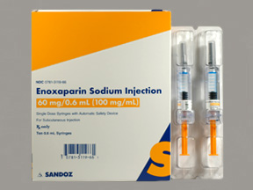
Lovenox (enoxaparin)
Side Effects
  Bleeding
  Pain, redness, irritation, or bruising at injection site
  Injection site hematoma
Monitoring Parameters
  No routine monitoring UNLESS patient is obese or low-weight, has significant kidney impairment, or pregnant, then monitor anti-Xa levels
Image available at: <https://healthy.kaiserpermanente.org/static/drugency/images/SDZ31190.JPG>.
“Lovenox.” Accessed March 16, 2013. Available online at: <www.lovenox.com>.
“Lovenox.” UpToDate. Accessed March 16, 2013. Available online at: <www.uptodate.com>.
Notes:
Teaching point: In general – no monitoring required!

Slide 39
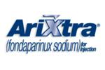
Arixtra (fondaparinux)
Purpose
  Prevention of deep vein thrombosis (DVT) in patients undergoing surgery for hip or knee replacement, hip fracture, or abdominal surgery
  Treatment of pulmonary embolism (PE) or deep vein thrombosis
Dosing
  SUBCUTANEOUS INJECTION ONLY
  DVT prevention (patients must weigh at least 110lbs for use): 2.5 mg once daily, duration is usually 5-9 days
  DVT/PE treatment: Dose is based on weight, duration is usually 5-7 days as patient stabilizes on Coumadin
Image available at: <http://www.pharma-agora.com/upload/uyelikler/3452972-arixtra.jpg>.
“Arixtra.” UpToDate. Accessed March 17, 2013. Available at: <www.uptodate.com>.
Notes:
Start warfarin on 1st or 2nd day of treatment and continue Arixtra until INR is at least 2.0 x 24 hours

Slide 40
Arixtra (fondaparinux)
Dosage Strengths
  2.5 mg/0.05.mL, 5 mg/0.4mL, 7.5 mg/0.6mL, 10 mg/0.8mL prefilled syringes
Administration
  Each syringe is for a single, one-time use ONLY
  High alert medication = increased risk of serious side effects if used in error
“Arixtra.” UpToDate. Accessed March 17, 2013. Available at: <www.uptodate.com>.
“Arixtra.” GSK. Accessed March 17, 2013. Available at: <http://www.gsksource.com>.

Slide 41
Arixtra (fondaparinux)
Special Considerations
  Use with caution in patients age 75 years and older
  Use with caution in patients weighing less than 110lbs who are being treated for DVT/PE
Side Effects
  Fever
  Nausea
  Anemia
  Injection site bleeding, rash, or itching
“Arixtra.” UpToDate. Accessed March 17, 2013. Available at: <www.uptodate.com>.
“Arixtra.” GSK. Accessed March 17, 2013. Available at: <http://www.gsksource.com>.
Notes:
For prevention, it is not recommended to be used in patients weighing <110 lbs, but for treatment it is recommended to be used with caution (thus best to pick an alternate agent for both scenarios if patient weighs <110 lbs).

Slide 42
Antiplatelet Agents
Ecotrin (aspirin)
Plavix (clopidogrel)
Aggrenox (dipyridamole/aspirin)
Effient (prasugrel)
Brilinta (ticagrelor)

Slide 43
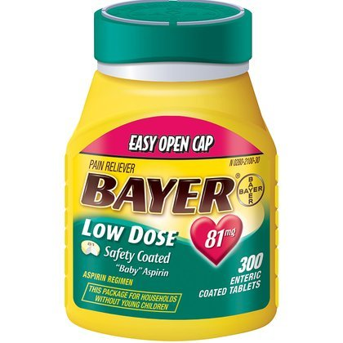
Ecotrin (aspirin)
Purpose
  Prevention and treatment of acute coronary syndromes (such as heart attack), ischemic stroke, and transient ischemic attacks (TIA)
Dosing
  Cardiovascular disease prevention: 81 mg once a day
  Acute coronary syndrome, ischemic stroke, or TIA: 162-325mg given on presentation (patient should chew aspirin in this setting)
Dosage Strengths
  81 mg (“baby aspirin”), 325 mg, 500 mg available in various formulations
Image available at:<http://freestufffinder.com/wp-content/uploads/2012/03/Bayer-Aspirin.jpg>.
“Aspirin.” UpToDate. Accessed March 17, 2013. Available online at: <www.uptodate.com>.
Notes:
Note: aspirin is available in all different types of formulations including caplets, rectal suppository, tablet, chewable tablets, buffered tablets, enteric coated tablets.

Slide 44
Ecotrin (aspirin)
Administration
  Take with food or a full glass of water to minimize stomach upset
Special Considerations
  May consider adding a gastroprotective agent in certain patients
  Avoid use with other NSAIDs as this can decrease the cardioprotective effects of aspirin
Side Effects
  Bleeding
  Stomach upset (nausea, vomiting, pain, heartburn)
  Gastrointestinal ulceration or erosions
“Aspirin.” UpToDate. Accessed March 17, 2013. Available online at: <www.uptodate.com>.
Notes:
Beers: do not use doses >325mg. Primary prevention with ASA in patients 80 years or older is debatable – benefit vs. risk considerations.
Note: a nonselective NSAID can decrease the cardioprotective effect of aspirin.
Gastroprotective agent: PPI or misoprostol.
DO NOT USE in children or teenagers – typically anyone under 18 YO presenting with chickenpox or flu symptoms as this could precipiate Reye Syndrome.

Slide 45
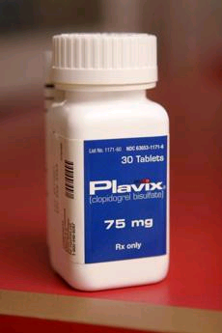
Plavix (clopidogrel)
Purpose
  Reduces rate of atherothrombotic events (heart attack, stroke, vascular deaths) in patients with a recent heart attack, stroke, or peripheral artery disease or in patients with percutaneous coronary intervention (PCI) or coronary artery bypass graft (CABG)
Dosing
  75 mg once daily
Dosage Strengths
  75 mg, 300 mg tablets
Image available at: <http://www.bostonglobe.com/rf/image_r/Boston/2011-2020/2012/02/09/BostonGlobe.com/Business/Images/09plavix__photo1.r.jpg>.
“Plavix.” Bristol-Myers Squibb. Accessed March 17, 2013. Available online at: <http://packageinserts.bms.com/pi/pi_plavix.pdf>.
Notes:
Of note, in patients with unstable angina or NSTEMI – the dose is 300mg x 1 then 75 mg once a day for 12 months and the CHEST guidelines recommend combination of aspirin dose 81 mg as well. For STEMI – also do combination

Slide 46
Plavix (clopidogrel)
Black Box Warning: Patients with reduced CYP2C19 function (determined by genetic testing) may lead to reduced efficacy of Plavix, and thus have a higher risk for cardiovascular events.
Special Considerations
  Drug interaction with proton pump inhibitors (PPIs) such as Prilosec (omeprazole)
  Combination of Plavix and aspirin together is controversial as both medications are antiplatelet agents and can increase bleed risk
Side Effects
  Bleeding
“Plavix.” Bristol-Myers Squibb. Accessed March 17, 2013. Available online at: <http://packageinserts.bms.com/pi/pi_plavix.pdf>.
Notes:
DDI with proton pump inhibitors (per UpToDate): May decrease serum concentrations of the active metabolite(s) of Clopidogrel. Management: Due to the possible risk for impaired clopidogrel effectiveness, clinicians should carefully consider the need for proton pump inhibitor therapy in patients receiving clopidogrel. Other acid-lowering therapies do not appear to share this interaction (such as H₂ antagonists like Zantac).
Combination use of Plavix and aspirin: Combination use may be warranted in certain situations:
Unstable angina
Heart attack
Percutaneous coronary intervention for acute coronary syndrome

Slide 47

Aggrenox (aspirin/dipyridamole)
Purpose
  Reduce risk of stroke in patients who have had a transient ischemic attack (TIA) or ischemic stroke due to a clot
Dosing
  One capsule twice a day
Dosage Strengths
  Each capsule contains: aspirin 25 mg and extended-release dipyridamole 200 mg
“Aggrenox.” Accessed March 17, 2013. Available online at: <www.aggrenox.com>.

Slide 48
Aggrenox (aspirin/dipyridamole)
Side Effects
  Headache
  Abdominal pain
  Stomach upset
  Nausea
  Diarrhea
“Aggrenox.” Accessed March 17, 2013. Available online at: <www.aggrenox.com>.

Slide 49

Effient (prasugrel)
Purpose
  Reduces rate of clot formation and resulting complications in patients with percutaneous coronary intervention (PCI) for unstable angina or heart attack
Dosing
  PCI for unstable angina or heart attack: loading dose of 60 mg ASAP then 10 mg once daily (in combination with low-dose aspirin)
  Low body weight (less than 132lbs) influences dosing considerations
Dosage Strengths
  5 mg, 10 mg tablets
“Effient.” Eli Lilly and Company. Accessed March 17, 2013. Available online at: <www.effient.com>.
Notes:
PCI – such as stent placement (drug eluting stent or bare metal stent).

Slide 50
Effient (prasugrel)
Black Box Warnings:
  Use is not recommended in patients age 75 years or older due to increased risk of fatal and intracranial bleeding and uncertain benefit
  May cause significant or fatal bleeding
  Discontinue at least 7 days before ANY surgery
Special considerations
  DO NOT USE in patients with a history of transient ischemic attack or stroke
Side Effects
  Bleeding
  High blood pressure
  Headache
“Effient.” Eli Lilly and Company. Accessed March 17, 2013. Available online at: <www.effient.com>.
Notes:
BBW: Use may be considered in patients 75 years and up in high-risk situations (patients with DM or history of MI). Contraindicated in patients with active bleeding or history of TIA or stroke.

Slide 51

Brilinta (ticagrelor)
Purpose
  Used in combination with aspirin for secondary prevention of thrombotic events in patients with unstable angina, previous heart attack, or with percutaneous coronary intervention (PCI) and/or coronary artery bypass graft (CABG)
Dosing
  Loading dose of 180 mg (with aspirin 325 mg) then maintenance dose of 90 mg twice a day (with 81 mg aspirin daily)
Dosage Strengths
  90 mg tablets
“Brilinta.” AstraZeneca. Accessed March 17, 2013. Available online at: <www.brilintatouchpoints.com>.
Notes:
Typical duration = 12 months after event

Slide 52
Brilinta (ticagrelor)
Black Box Warnings:
  Brilinta increases the risk of bleeding including significant and sometimes fatal bleeding; thus, do not use in patients with active bleeding or history of intracranial hemorrhage
Special Considerations
  Use with caution in patients with gout
  Avoid maintenance doses of aspirin greater than 100 mg a day as this reduces the efficacy of Brilinta
  Discontinue at least 5 days before ANY surgery
  Lots of drug interactions
“Brilinta.” AstraZeneca. Accessed March 17, 2013. Available online at: <www.brilintatouchpoints.com>.
Notes:
Do not start this medication in patients likely to undergo CABG

Slide 53
Brilinta (ticagrelor)
Side Effects
  Bleeding
  Shortness of breath
  Difficulty breathing
  Headache
“Brilinta.” AstraZeneca. Accessed March 17, 2013. Available online at: <www.brilintatouchpoints.com>.

Slide 54
General Considerations for Anticoagulation

Slide 55
Important Concepts to Remember
Patients with high risk of falls have a higher risk of bleeding complications
Elderly patients are at increased risk for both clotting issues and bleeding issues
As age ↑ and kidney function ↓, medications (such as anticoagulants or antiplatelet agents) can stick around longer in the body putting older patients at higher risk for bleeding side effects
Co-morbidities such as uncontrolled hypertension, heart failure, diabetes, and liver impairment can also increase patients risk for bleeding
Torn M, Bollen W, van der Meer F, et al. Arch Intern Med. 2005;165:1527-1532.

Slide 56
Important Concepts to Remember
Avoid alcohol use – can increase both the risk of stomach irritation as well as bleeding risk
Always consider drug interactions and/or dietary interactions
These medications can save lives, but they can also be dangerous if used in error

Slide 57
Patient Safety with the *Five Rights*
Right patient?
Right drug?
Right time?
Right dose?
Right route?
“ISMP Medication Safety Alert.” Accessed March 17, 2013. Available online at: <http://www.ismp.org/newsletters/nursing/issues/nurseadviseerr200411.pdf>.

Slide 58
Warning Signs with Anticoagulation
Signs of Bleeding | Signs of Clot Formation
Bleeding in urine or stool Bleeding gums Nose bleeds Bruising | Deep vein thrombosis (DVT) Redness Pain Warmth Pulmonary embolism (PE) Shortness of breath Chest pain

Slide 59

Questions?

