Slide 1
New and Emerging Anticoagulants
Samantha Faulkner
PharmD Candidate
Class of 2012
February 21, 2012

Slide 2
Objectives
Summarize current anticoagulant therapy
Describe new and emerging anticoagulant agents
Discuss the role of new agents in the geriatric population

Slide 3
Background

Slide 4
Anticoagulation for Atrial Fibrillation
Stroke is the most common and devastating complication of A. Fib
Aspirin 81-325 mg daily
  Only recommended for low risk patients (CHADS₂ score 0-1)
Warfarin (INR 2-3)
  Recommended for moderate-high risk patients (CHADS₂ score ≥1)

Slide 5
CHADS₂ Score
CHF – 1 point
HTN – 1 point
Age ≥75 yo – 1 point
DM – 1 point
Stroke or TIA – 2 points
Notes:
Estimates the stroke risk in A. fib

Slide 6
CHA₂DS₂-VASc Score
CHF/LV dysfunction – 1 point
HTN – 1 point
Age ≥75 yo – 2 points
DM – 1 point
Stroke/TIA – 2 points
Vascular Disease – 1 point
Age 65-74 yo – 1 point
Sex (female) – 1 point
Notes:
0 – low risk
1 – intermediate risk
2 – high risk
Males are more likely to have A. Fib
But females are more likely to have stroke w/A. Fib
Not yet used in the guidelines

Slide 7
Postoperative Thromboprophylaxis in Hip and Knee Replacement
LMWH (Lovenox®) 30mg SC BID
  started 12-24hrs after surgery X 10days
  30mg daily for CrCl <30 mL/min
Fondaparinux (Arixtra ®) 2.5 mg SC daily
  started 6hrs after surgery X 11days
  contraindicated in pts <50kg or CrCl <30 mL/min
Warfarin (INR 2-3)
  started pre-op or the evening of the surgical day
Notes:
Lovenox for at least 10 days for hip/knee replacement
(1) LMWH (at a usual high-risk dose, started 12 h before surgery or 12 to 24 h after surgery, or 4 to 6 h after surgery at half the usual high-risk dose and then increasing to the usual high-risk dose the following day); (2) fondaparinux (2.5 mg started 6 to 24 h after surgery); or (3) adjusted-dose VKA started preoperatively or the evening of the surgical day (international normalized ratio [INR] target, 2.5; INR range, 2.0 to 3.0) (all Grade 1A).

Slide 8
Clotting Cascade

Slide 9
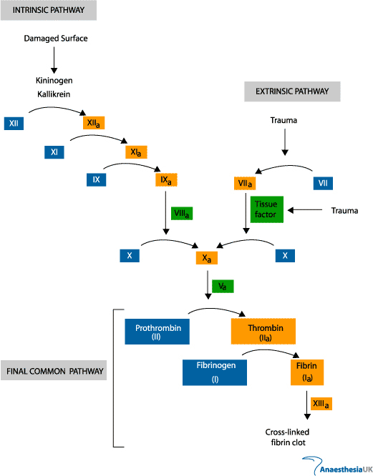
Notes:
Clotting Cascade

Slide 10
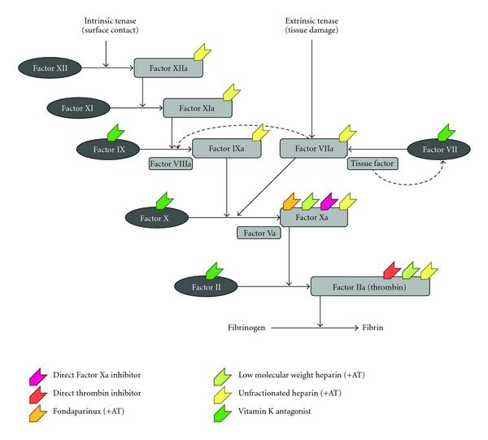
Notes:
Where each anticoagulant works in the clotting cascade

Slide 11
Direct Thrombin Inhibitors
Dabigatran

Slide 12
Dabigatran Etexilate (Pradaxa®)
FDA approved Oct 19, 2010
Dosage form:
  75 mg capsule
  150 mg capsule

Slide 13
Dabigatran
Indication:
  Prevention of stroke and systemic embolism in nonvalvular atrial fibrillation
Dosing:
  150 mg PO BID
  If CrCl 15-30 mL/min, decrease to 75 mg BID
  If CrCl < 15 mL/min, not recommended
Notes:
Note: CrCl < 30 mL/min were excluded from the trial RE-LY, the 75mg dose has not been studied and was based on pharmacokinetics.

Slide 14
Dabigatran
Conversion from warfarin:
  Initiate when INR < 2.0
Conversion to warfarin (based on CrCl):
  CrCl > 50 mL/min: Initiate warfarin 3 days prior to d/c of dabigatran
  CrCl 31-50 mL/min: Initiate warfarin 2 days prior to d/c of dabigatran
  CrCl 15-30 mL/min: Initiate warfarin 1 day prior to d/c of dabigatran
Notes:
Note: Dabigatran contributes to INR elevation, wait ≥ 2 days after d/c dabigatran to check INR

Slide 15
Dabigatran
Administration:
  PO: do not break, chew, or open capsules (this will lead to 75% increase in absorption and potentially serious AEs). Take with water
Storage:
  Blister: room temp and protect from moisture
  Bottle: room temp, dispense and store in original manufacturer's bottle to protect from moisture, discard 4 mos. after opening original container
Notes:
Requires an acid environment for absorption
Capsules contain multiple drug pellets, each pellet has tartaric acid core (coated with drug) that creates an acidic microenvironment to improve dissolution and absorption independent of gastric pH

Slide 16
Dabigatran MOA
Dabigatran etexilate (prodrug)
Converted in vivo by plasma and hepatic esterases
Active dabigatran
A specific, direct thrombin (both free & fibrin-bound) inhibitor
Inhibiting coagulation
Notes:
Dabigatran etexilate is a prodrug, converted in vivo by plasma and hepatic esterases to active dabigatran
Specific, direct thrombin inhibitor (both free and fibrin-bound thrombin) thus inhibiting coagulation

Slide 17
Dabigatran
P-glycoprotein substrate (NOT CYP P450)
CrCl 15-30mL/min + P-gp inhibitor: avoid
Drug Interactions
P-gp inhibitors | P-gp inducers
Ketoconazole | Rifampin*
Verapamil (take 2hrs after) | Carbamazepine*
Amiodarone
Quinidine
Dronedarone | *contrindicated
Notes:
If CrCl 30-50 + P-gp inhibitor: consider dose reduction to 75mg BID
P-gp is an efflux transporter found in the intestine, liver, and kidney
Not a substrate of CYP P450
P-glycoprotein substrate
P-gp inhibitors
Ketoconazole – AUC ↑ by 153%
Verapamil - effect depended on formulation and timing of administration of verapamil
1 hr before - AUC ↑ by 250%
concurrent admin - AUC ↑ by 170%
2 hr after – no change
Amiodarone – AUC ↑ by 58%; renal cl ↑ by 65%
Quinidine – AUC ↑ by 53%
P-gp inducers
Rifampin – AUC ↓ by 66% (contraindicated)
No interaction with PPIs, H₂ antag, or digoxin
Dronedarone with Cl_{cr} 30-50 mL/minute: Consider dabigatran dose reduction to 75 mg twice daily
Ketoconazole (oral) with Cl_{cr} 30-50 mL/minute: Consider dabigatran dose reduction to 75 mg twice daily
Any P-glycoprotein inhibitor (including dronedarone and ketoconazole) with Cl_{cr} 15-30 mL/minute: Avoid concurrent use.
P-glycoprotein/ABCB1 Inducers (rifampin): May decrease the serum concentration of Dabigatran Etexilate. Management: Avoid concurrent use of dabigatran with a p-glycoprotein inducer when possible. Closely monitor for decreased levels/effects of dabigatran if concomitantly administering a p-glycoprotein inducer, particularly strong inducers. Risk X: Avoid combination
P-glycoprotein/ABCB1 Inhibitors: May increase serum concentrations of the active metabolite(s) of Dabigatran Etexilate. Management: Dabigatran dose reductions may be needed. Specific recommendations vary considerably according to US vs Canadian labeling, specific P-gp inhibitor, renal function, and indication for dabigatran treatment. Refer to full monograph or dabigatran labeling. Risk D: Consider therapy modification

Slide 18
Dabigatran
Monitoring:
  No specific monitoring available
Adverse Effects:
  Dyspepsia (11%)
  Bleeding (8-33%; major ≤6%)
  GI bleed (≤6%)
Notes:
At therapeutic dabigatran doses, aPTT, ECT (ecarin clotting time), and TT (thrombin time) are prolonged

Slide 19
Dabigatran PK data
F: 3-7%
Time to peak: 1 hr
t_{1/2}: 12-17 hrs
  Elderly: 14-17 hrs
  Mild-mod renal impairment: 15-18 hrs;
  Severe renal impairment: 28 hours
Protein binding: 35%
Metabolism: Hepatic glucuronidation
Excretion: Urine (80%)
Notes:
Metabolism: Hepatic; dabigatran etexilate is rapidly and completely hydrolyzed to dabigatran (active form) by plasma and hepatic esterases; dabigatran undergoes hepatic glucuronidation to active acylglucuronide isomers (similar activity to parent compound; accounts for <10% of total dabigatran in plasma)

Slide 20
Dabigatran
Warning in Elderly:
  Use with extreme caution or consider other treatment options. No dosage adjustment is recommended in the U.S. labeling based on age alone (unless renal impairment coexists); however, numerous case reports of hemorrhage (including hemorrhagic stroke) have been reported in elderly patients (median age: 80 years), with a quarter of these reports occurring in patients ≥84 years of age. Some reports have resulted in fatality, particularly in those with low body weight and mild-to-moderate renal impairment; the risk is expected to be higher in patients receiving other interacting drugs (eg, amiodarone) (Legrand, 2011).

Slide 21
Reversal of Dabigatran
No specific antidote for reversal exists
Severe hemorrhage consider:
  Transfusions of fresh frozen plasma
  Packed red blood cells
Use of a prothrombin complex concentrate (PCC) has been shown to be ineffective
Notes:
No specific antidote exists for dabigatran reversal. Therapy for severe hemorrhage may include transfusions of fresh frozen plasma, packed red blood cells, or surgical intervention when appropriate (Wann, 2011). The use of a prothrombin complex concentrate (PCC) (Cofact®, not available in the U.S.) has been shown to be ineffective for dabigatran reversal (Eerenberg, 2011).

Slide 22
RE-LY Trial
Efficacy Results:
  Dabigatran 150 mg BID was superior to warfarin in preventing stroke/systemic embolism in patients with A. Fib
Safety Results:
  Rate of overall major bleeding were similar
    Lower hemorrhagic bleeds with dabigatran
    Higher GI bleeds with dabigatran
Patients:
  CHADS₂ score 2.1; age 71 yo; warfarin TTR 67%
Notes:
Dabigatran vs. warfarin in patients w/ A. Fib
Randomized Evaluation of Long-Term Anticoagulation Therapy
In the RE-LY study, 82% of the patients enrolled were ≥65 years of age, with 40% ≥75 years of age. There was a trend towards increased risk of bleeding in elderly patients ≥75 years of age receiving 150 mg twice daily. Dabigatran is predominantly eliminated by the kidney; therefore, renal function should be closely monitored in elderly patients.

Slide 23
Factor Xa Inhibitors
Rivaroxaban
Apixaban

Slide 24
Rivaroxaban (Xarelto®)
FDA approved
  July 1, 2011 for postoperative thromboprophylaxis in hip and knee replacement
  Nov 4, 2011 for prevention of stroke and systemic embolism in patients with nonvalvular atrial fibrillation
Dosage form:
  10 mg tablet
  15 mg tablet
  20 mg tablet
Notes:
Indications:

Slide 25
Rivaroxaban Dosing
Post-op thromboprophylaxis
  Initiate 6-10 hrs post-op
  10 mg daily for 12-14 days (knee)
  10 mg daily for 35 days (hip)
  If CrCl <30 mL/min, not recommended
A. fib:
  20 mg once daily with food
  If CrCl 15-49 mL/min, decrease to 15 mg daily
  If CrCl < 15 mL/min, not recommended

Slide 26
Rivaroxaban
Conversion from warfarin:
  Initiate when INR < 3.0
Conversion to warfarin:
  Initiate warfarin and a parenteral anticoagulant 24 hrs after d/c of rivaroxaban
Notes:
Conversion to warfarin: Note: Rivaroxaban affects INR; therefore, initial INR measurements after initiating warfarin may be unreliable
Conversion from continuous infusion unfractionated heparin: Initiate rivaroxaban at the time of heparin discontinuation
Conversion to continuous infusion unfractionated heparin: Initiate continuous infusion unfractionated heparin 24 hours after discontinuation of rivaroxaban
Conversion from anticoagulants (other than warfarin and continuous infusion unfractionated heparin): Discontinue current anticoagulant and initiate rivaroxaban ≤2 hours prior to the next regularly scheduled evening dose of the discontinued anticoagulant.
Conversion to other anticoagulants (other than warfarin): Initiate the anticoagulant 24 hours after discontinuation of rivaroxaban

Slide 27
Rivaroxaban
Administration:
  Take with food if dose ≥15 mg/day (10 mg w/o regard to meals)
  Avoid administering via a feeding tube that delivers the rivaroxaban directly into the small intestine or ascending colon
Storage:
  At room temp
Notes:
A decrease in the AUC and C_{max} (29% and 56%, respectively) was observed when rivaroxaban was delivered to the proximal small intestine; further decreases may be seen with delivery to the distal small intestine or ascending colon. Avoid administering via a feeding tube that delivers the rivaroxaban directly into the small intestine or ascending colon.

Slide 28
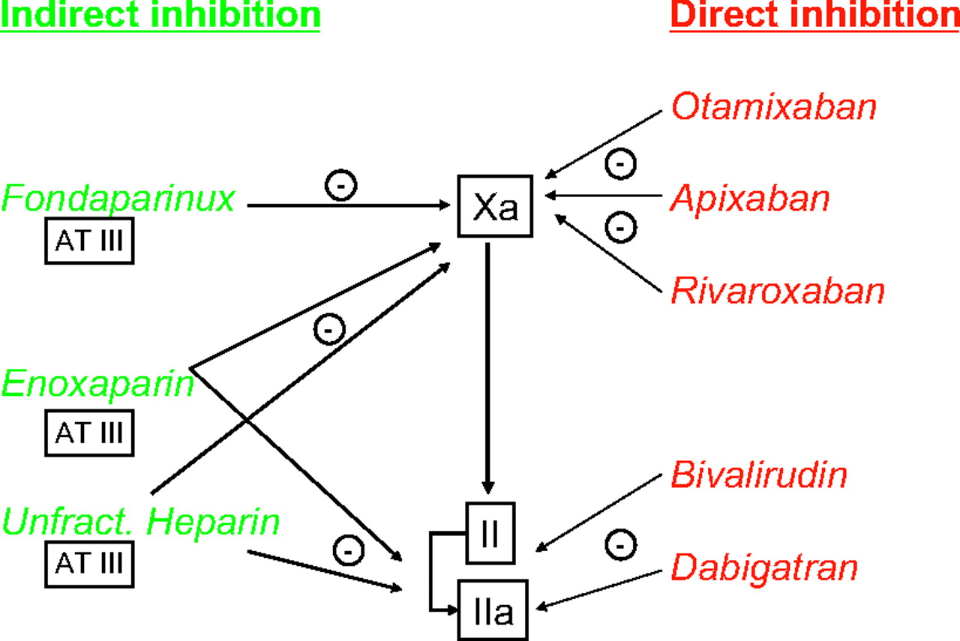
Rivaroxaban MOA comparison
Notes:
Inhibits platelet activation and fibrin clot formation via direct, selective and reversible inhibition of factor Xa (FXa) in both the intrinsic and extrinsic coagulation pathways. FXa, as part of the prothrombinase complex consisting also of factor Va, calcium ions, factor II and phospholipid, catalyzes the conversion of prothrombin to thrombin. Thrombin both activates platelets and catalyzes the conversion of fibrinogen to fibrin.

Slide 29
Rivaroxaban
Metabolized by CYP3A4 and P-glycoprotein
Drug Interactions
CYP3A4/P-gp inhibitors | CYP3A4/P-gp inducers
Ketoconazole * | Rifampin
Ritonavir* | Carbamazepine
Clarithromycin* | Phenytoin*
Erythromycin | St. John’s Wort*
*contraindicated
Notes:
Should be avoided
CYP3A4 and P-glycoprotein substrate
CYP3A4/P-gp inhibitors
Ketoconazole – AUC/Cmax ↑ by 100%
Ritonavir – AUC/Cmax ↑ by 100%
Clarithromycin – AUC/Cmax ↑ by 50%
Erythromycin – AUC/Cmax ↑ by 30%
CYP3A4/P-gp inducers
Rifampin – AUC ↓ by 50%
No interaction with digoxin

Slide 30
Rivaroxaban
Monitoring:
  Not recommended
    Prothrombin time (PT) to detect drug not for dose adjustment
Adverse Effects:
  Bleeding (6-21%; major ≤6%)
  GGT, ALT, AST increased (3-7%)
  Pruritus (2%)
  Extremity pain (2%)
Notes:
Central nervous system: Syncope (1%)
Dermatologic: Pruritus (2%), blister (1%)
Gastrointestinal: Nausea (1%)
Hematologic: Bleeding (DVT prophylaxis: 6% [major: <1%]; atrial fibrillation: 21% [major: 6%]), thrombocytopenia (<100,000/mm³ or <50% baseline: 3%), anemia (1%)
Hepatic: GGT increased (>3 times ULN: 7%), ALT increased (>3 times ULN: 3%), AST increased (>3 times ULN: 3%), bilirubin increase (>1.5 times ULN: 3%)
Local: Wound secretion (3%)
Neuromuscular & skeletal: Extremity pain (2%), muscle spasm (1%)

Slide 31
Rivaroxaban Black Box Warnings
An increased risk of stroke was noted upon d/c of rivaroxaban in clinical trials of pts w/ A. fib
Spinal or epidual hematomas, including subsequent paralysis, may occur with neuraxial anesthesia (epidural or spinal anesthesia) or spinal puncture in pts who are anticoagulated
Notes:
Discontinuation of therapy: [U.S. Boxed Warning]: An increased risk of stroke was noted upon discontinuation of rivaroxaban in clinical trials of patients with atrial fibrillation; consider the addition of alternative anticoagulant therapy when discontinuing rivaroxaban for reasons other than bleeding.
• Neuraxial anesthesia: [U.S. Boxed Warning]: Spinal or epidural hematomas, including subsequent paralysis, may occur with neuraxial anesthesia (epidural or spinal anesthesia) or spinal puncture in patients who are anticoagulated; the risk is increased with concomitant administration of other drugs that affect hemostasis (eg, NSAIDS, platelet inhibitors, other anticoagulants), in patients with a history of traumatic or repeated epidural or spinal punctures, or a history of spinal deformity or surgery. In patients who receive both rivaroxaban and neuraxial anesthesia, avoid removal of epidural catheter for at least 18 hours following last rivaroxaban dose; avoid rivaroxaban administration for at least 6 hours following epidural catheter removal; if traumatic puncture occurs, avoid rivaroxaban administration for at least 24 hours. Monitor for signs of neurologic impairment (eg, numbness/weakness of legs, bowel/bladder dysfunction); prompt diagnosis and treatment are necessary.

Slide 32
Rivaroxaban PK data
F: 80-100% (10 mg); 66% (20 mg fasting)
Time to peak: 2-4 hrs
t_{1/2}: 5-9 hrs
  Elderly: 11-13 hrs
Protein binding: 92-95%
Metabolism: Hepatic via CYP3A4/5 and CYP2J2
Excretion: Urine (66%); Feces (28%)
Notes:
Remember dose ≥15 mg take with food
Protein binding: ~92% to 95% (primarily to albumin)
Metabolism: Hepatic via CYP3A4/5 and CYP2J2
Bioavailability: Absolute bioavailability: 10 mg dose: ~80% to 100%; 20 mg dose: ~66% (fasting; increased with food)
Excretion: Urine (66% primarily via active tubular secretion [36% as unchanged drug; 30% as inactive metabolites]); feces (28% [7% as unchanged drug; 21% as inactive metabolites])
Greater than 50% of patients in the RECORD trials were ≥65 years; 15% were >75 years of age. Efficacy was found to be similar in younger and older patients. Rivaroxaban's mean AUC was found to be 52% greater in older men and 39% greater in older women compared to their younger counterparts. The mean AUC was 41% greater in persons >75 years of age. Rivaroxaban's half-life in older adults was 11-13 hours. These pharmacokinetic differences are thought to be due to decreased renal clearance.

Slide 33
Reversal of Rivaroxaban
Use of a prothrombin complex concentrate (PCC) has been shown to reverse the anticoagulant effect of rivaroxaban
Notes:
use of a prothrombin complex concentrate (PCC) has been shown to reverse the anticoagulant effect of rivaroxaban. In a randomized, double-blind, placebo-controlled, crossover trial enrolling healthy volunteers (n=12), subjects were administered either rivaroxaban 20 mg twice daily, a dose higher than what is currently approved, or dabigatran 150 mg twice daily for 2.5 days followed by administration of 50 int. units/kg of PCC (Cofact®, not available in the U.S.), or placebo. Cofact® contains factors II, VII, IX, X, protein C, protein S, and antithrombin. Upon receipt of PCC in those receiving rivaroxaban, the prothrombin time and endogenous thrombin potential [ETP], a measure of thrombin generation, normalized immediately or within 15 minutes, respectively, after administration and were sustained for 24 hours whereas administration of PCC did not have an effect on the aPTT, ETP, thrombin time, or ecarin clotting time in the dabigatran group. Interestingly, in the rivaroxaban group, ETP continued to rise higher than baseline possibly indicating too high of a dose; therefore, further clinical trials are necessary to determine if lower doses are just as effective; no clinically relevant complications occurred during the trial (Eerenberg, 2011). Note: The use of a 50 int. unit/kg dose of another PCC may not produce similar results seen in this study; therefore, caution is advised when using other available PCCs for this indication.

Slide 34
ROCKET AF Trial
Efficacy Results:
  Rivaroxaban non-inferior to warfarin in A. fib
Safety Results:
  Rates of major bleeding were similar and non-significant
Patients:
  CHADS₂ score 3.5; age 73 yo; warfarin TTR 55%
Notes:
Rivaroxaban Once Daily Oral Direct Factor Xa Inhibition Compared with Vitamin K Antagonism for Prevention of Stroke and Embolism Trial in Atrial Fibrillation
Rivaroxaban versus Warfarin in Nonvalvular Atrial Fibrillation

Slide 35
RECORD trial
Efficacy Results:
  Rivaroxaban was superior to enoxaparin for thromboprophylaxis after total knee and hip arthroplasty
Safety Results:
  Similar rates of bleeding
Patients:
  Average age 68 yo (28-91)
Notes:
RECORD: Venous Blood Clot Prevention in Major Orthopedic Surgery
REgulation of Coagulation in major Orthopedic surgery reducing the Risk of DVT and PE
Rivaroxaban was superior to enoxaparin for thromboprophylaxis after total knee arthroplasty, with similar rates of bleeding.

Slide 36
Apixaban (Eliquis®)
Not yet FDA approved
Indications studied:
  Prevention of VTE postoperative in patients undergoing knee and hip surgery
  Stroke prevention in patients with A. fib
  In combination w/antiplatelet therapy for ACS
Dosage Form:
  2.5 mg tablet
  5 mg tablet

Slide 37
Apixaban Dosing
Post-op thromboprophylaxis
  Initiate 12-24hrs after surgery
  2.5 mg BID for 10-14 days (knee)
  2.5 mg BID for 35 days (hip)
  CrCl <15 mL/min, not recommended
A. fib:
  5 mg BID
  If age >80 yo, weight <60 kg, or SCr >1.5 mg/dL: 2.5mg PO BID (A. fib)
Notes:
2.5-5 mg PO qday-bid have been studied

Slide 38
Apixaban MOA
Selective factor Xa inhibitor
Prevents thrombin generation
Prevents thrombus development
Inhibits platelet aggregation
Notes:
Reversible, direct, selective factor Xa inhibitor, preventing thrombin generation and thrombus development. No direct effects on platelet aggregation, but indirectly inhibits platelet aggregation induced by thrombin.

Slide 39
Apixaban – Drug Interactions
CYP3A4 and P-glycoprotein substrate
Drug Interactions
CYP3A4/P-gp inhibitors (may ↑ conc. by 2-fold) | CYP3A4/P-gp inducers (may ↓ conc. by half)
Ketoconazole * | Rifampin
Voriconazole* | Carbamazepine
Ritonavir* | Phenytoin
 | St. John’s Wort
Notes:
Inhibitors of both CYP3A4 and P-gp, such as azole-antifungals (ketoconazole, voriconazole, etc.) and HIV protease inhibitors (ritonavir). May increase apixaban exposure by 2-fold or greater
Inducers of both CYP3A4 and P-gp, such as rifampicin, phenytoin, carbamazepine, Phenobarbital, or St. Johns Wort. May decrease mean apixaban AUC by 54% and C_{max} by 42% (use with caution)
CYP3A4/P-gp inhibitors
Ketoconazole – AUC ↑ by 100%
CYP3A4/P-gp inducers
Rifampin – AUC ↓ by 50%
No interaction with digoxin

Slide 40
Apixaban
Monitoring: factor Xa level studied
Adverse Effects:
  Common:
    Anemia
    Hemorrhage
    Nausea
  Uncommon:
    Thrombocytopenia
    Hypotension
    Epistaxis
    Transaminases increased
    Hematuria

Slide 41
Apixaban PK data
F: 66%
Time to peak: 1-3 hrs
t_{1/2}: 12 hrs
Protein Binding: 87%
Metabolism: mainly CYP3A4
Excretion: Fecal (55%), Urine (25%)

Slide 42
Reversal of Apixaban
No specific antidote for reversal exists
  Discontinue apixaban
  Transfusion of fresh frozen plasma
  Hemorrhagic complication → surgical homeostasis
  If life-threatening bleeding cannot be controlled may consider recombinant factor VIIa
Notes:
Activated charcoal may be considered (AC in dogs up to 3 hrs after ingestion demonstrated reduced exposure)

Slide 43
ARISTOTLE Trial
Efficacy Results:
  Apixaban was superior to warfarinin preventing stroke/systemic embolism in patients with A. fib
Safety Results:
  Rate of major bleeding was lower with Apixaban
    Intracranial hemorrhage 0.33% vs. 0.80%
Patients:
  CHADS₂ score 2.1; age 70 yo; warfarin TTR 62%
Notes:
Apixaban for Reduction in Stroke and Other Thromboembolic Events in Atrial Fibrillation
Apixaban vs. Warfarin in Patients with Atrial Fibrillation

Slide 44
Advance Trial
Efficacy Results:
  Apixaban demonstrated superior reduction in VTE and all cause death compared to enoxaparin
Safety Results:
  Bleeding rates were similar
Patients:
  Average Age – 61 yo
Notes:
Apixaban demonstrated a statistically superior reduction in the primary endpoint, a composite of all
VTE/all cause death, and in the Major VTE endpoint, a composite of proximal DVT, non-fatal PE, and
VTE-related death, compared to enoxaparin in both elective hip or knee replacement surgery (see
Table 2).
The overall incidences of adverse reactions of bleeding, anaemia and abnormalities of transaminases
(e.g., alanine aminotransferase levels) were numerically lower in patients on apixaban compared to
enoxaparin in the phase II and phase III studies in elective hip and knee replacement surgery.

Slide 45
Summary

Slide 46
Comparison
 | Dabigatran | Rivaroxaban | Apixaban
Brand name | Pradaxa® | Xarelto® | Eliquis®
FDA approved | 2010 | 2011 | Not yet approved
MOA | Direct thrombin inhibitor | Factor Xa inhibitor | Factor Xa inhibitor
Indications | fib | A. fib; hip/knee replacement | Studied in A. fib; hip/knee replac
Dosage | 75; 150 mg cap | 10,15, 20 mg tab | 2.5, 5 mg tab
Frequency | BID | Daily | BID
T_{max} | 1 hr | 2-4 hrs | 1-3 hrs
t_{1/2} | 12-17 hrs | 5-9 hrs | 12 hrs
t_{1/2} in elderly | 14-17 hrs | 11-13 hrs | Unknown
Notes:
Monitoring
Dis

Slide 47
Comparison Cont.
 | Dabigatran | Rivaroxaban | Apixaban
Metabolism | Liver | Liver | Liver
Major Drug Interactions | Ketoconazole; Amiodarone; Verapamil Rifampin*; Carbamazepine;* | Ketoconazole*; Ritonavir*; Clarithromycin*; Phenytoin*; Rifampin; Carbamazepine | Ketoconazole*; Voriconazole*; Ritonavir*; Phenytoin; Rifampin; Carbamazepine *
Dialyzability | Yes | Not expected | Unlikely
Reversibility | No antidote | PCC effective | Unknown
Side Effects | Dyspepsia; GI bleed | Bleeding; pruritis; ↑liver enzymes | Bleeding, nausea, anemia
Monitoring | None available | PT (detects drug) | Faxtor Xa level

Slide 48
Dosing for Stroke Prevention in A. fib
Drug | Dose
Dabigatran | CrCl >30 mL/min: 150 mg PO BID CrCl 15-29 mL/min: 75 mg PO BID CrCl <15 mL/min: Not recommended
Rivaroxaban | CrCl ≥50 mL/min: 20 mg PO daily CrCl 15-49 mL/min, 15 mg daily CrCl < 15 mL/min, Not recommended
Apixaban | 5 mg PO BID Age >80 yo, wt <60 kg, or SCR >1.5 mg/dL, 2.5 mg PO BID

